Slide 1
Part II
Elementary Statistical Methods
Descriptive Statistics

Slide 2
Elementary Statistical Methods
Chapter 2
Frequency Distributions and Graphs
Slides are made by
Tamer Oraby
UTRGV

Slide 3
Outline:
Summarizing variables in frequency tables and relative frequency tables.
Some graphical representation for variables: quantitative and qualitative.

Slide 4
2.1 Organizing Data
Organizing Data
Qualitative
Tables
- Frequency (F)
- Relative frequency (RF)
Graphs
- Bar graph
- Pie chart
Quantitative
Discrete
Continuous
Tables
- F & RF
Tables
- F & RF
Graphs
-Histogram F & RF
-Dot plot
Graphs
- Histogram F & RF
- Polygon F and RF
- Ogive
- Stem-and-leaf
- Box plot (next chapter)

Slide 5
Definition: Frequency distribution table shows data values and the number of times they occur.
Frequency is the count of times an item appears
Relative frequency = $\frac{Frequency}{Total frequency}$
which is like a probability

Slide 6
Qualitative variables

Slide 7
Example :
Blood Type A phlebotomist
draws the blood of a random
sample of 50 patients and
determines their blood types
as shown:
O | O | A | A | O
B | O | B | A | O
AB | B | A | B | AB
O | O | A | A | O
AB | O | A | B | A
O | A | A | O | A
O | A | O | AB | A
O | B | A | A | O
O | O | O | A | O
O | A | O | A | O

Slide 8
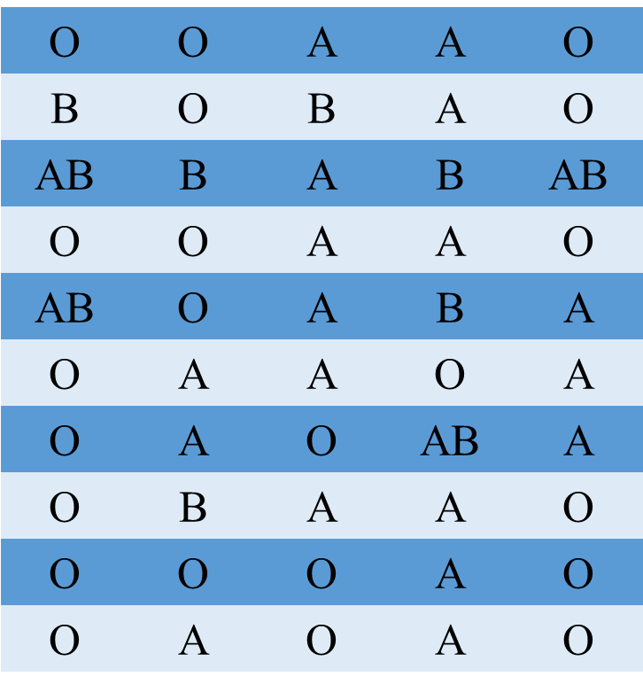
(a) Construct a frequency distribution table
(b) Construct a relative frequency distribution table
Blood type | Tally | Frequency | Relative frequency
A | |||| |||| | 10 | 10/50=0.2
B | |||| |||| || | 12 | 12/50=0.24
AB | |||| |||| |||| ||| | 18 | 18/50=0.36
O | |||| |||| | 10 | 10/50=0.2
Total |  | 50 | 1

Slide 9
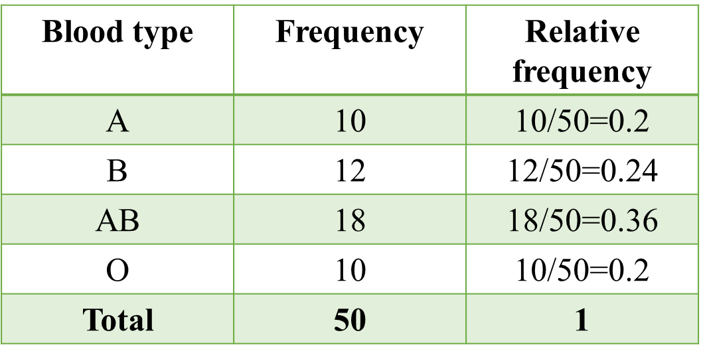
(c) Construct a frequency bar graph
(d) Construct a relative frequency bar graph

Slide 10
(e) Construct a pie chart

Slide 11
Example :
Dream Job A survey of adult men and women asked, “Which one of the following jobs would you most like to have?” The results of the survey are shown in the table.
Response | Men | Women
Professional athlete | 40 | 30
Actor/actress | 26 | 37
President of the United States | 13 | 13
Rock star | 13 | 13
Not sure | 7 | 19

Slide 12
(a) Construct a relative frequency distribution for men and women.
Response | Relative frequency
 | Men | Women
Professional athlete | 40/99=0.40404 | 30/112=0.27
Actor/actress | 26/99=0.26263 | 37/112=0.33
President of the United States | 13/99=0.13139 | 13/112=0.115
Rock star | 13/99=0.13139 | 13/112=0.115
Not sure | 7/99=0.07071 | 19/112=0.17

Slide 13
(b) Construct a side-by-side frequency bar graph.
Not the right way
to compare between
the two groups since
the number of men
and women are different
So use the following graph
…..

Slide 14
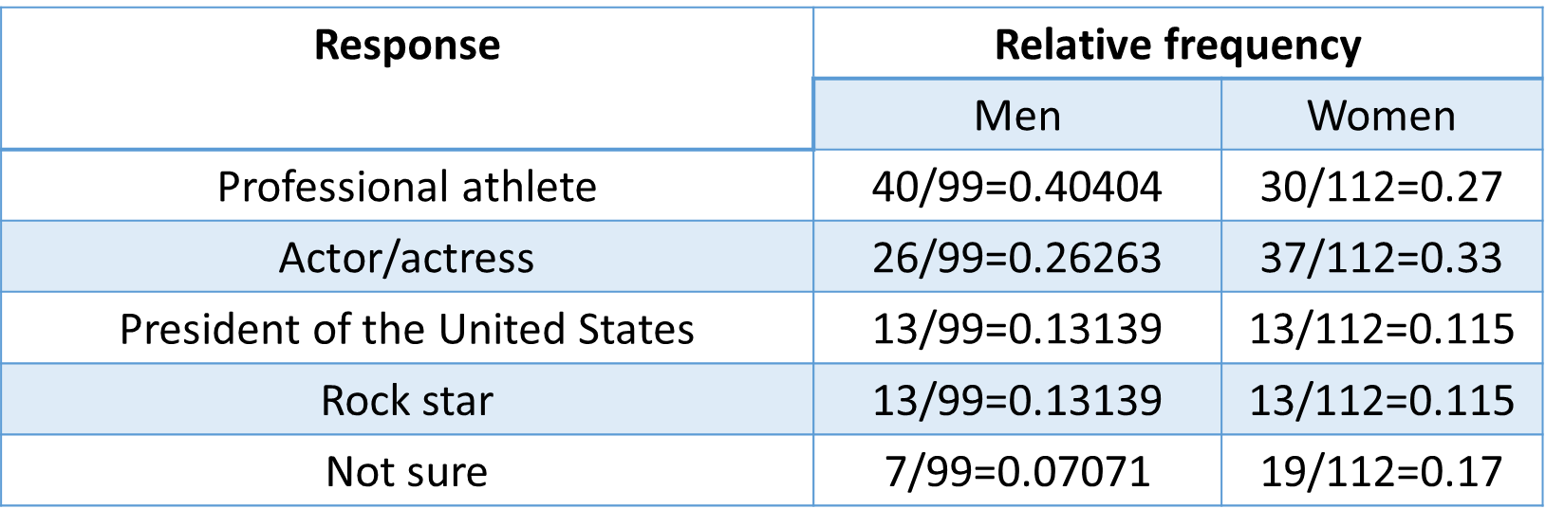
(c) Construct a side-by-side relative frequency bar graph.

Slide 15
(d) Construct a stacked relative frequency bar graph.

Slide 16
(e) Construct a horizontal side-by-side relative frequency bar graph.

Slide 17
Quantitative variables

Slide 18
2.2 Quantitative Data
Discrete
Tables
Histogram
j
Continuous
Tables
Histogram
–––––––-
Dot plot
Line plot
Polygon
–––––––-
Frequency and
Relative frequency

Slide 19
Discrete variable

Slide 20
Example :
Predicting School Enrollment To predict future enrollment, a local school district wants to know the number of children in the district under the age of 5. Fifty households within the district were sampled, and the head of household was asked to disclose the number of children under the age of 5 living in the household. The results of the survey are presented in the following table.
Number of children under 5 | Number of households
0 | 16
1 | 18
2 | 12
3 | 3
4 | 1

Slide 21
(a) Construct a relative frequency distribution of the data
Number of children under 5 | Number of households | Relative frequency | Percentage
0 | 16 | 16/50 | 32%
1 | 18 | 18/50 | 36%
2 | 12 | 12/50 | 24%
3 | 3 | 3/50 | 6%
4 | 1 | 1/50 | 2%
Total | 50 | 1 | 100%
(b) What percentage of households has two children under the age of 5?
24%
(c) What percentage of households has one or two children under the age of 5?
36%+24%=60%

Slide 22
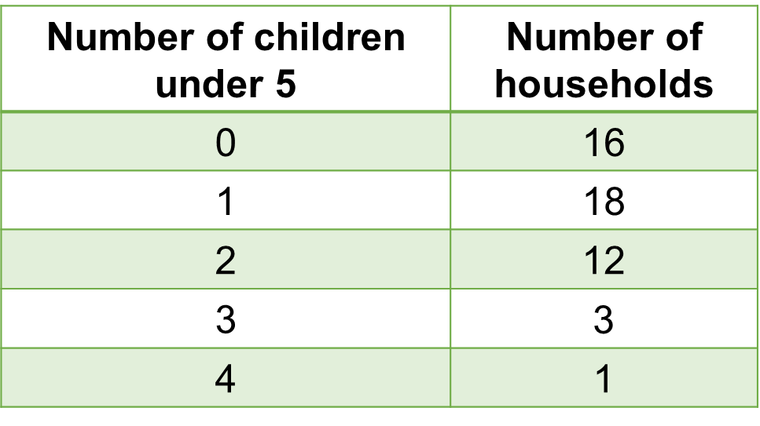
(d) Plot a frequency histogram for the number of households.

Slide 23
Example :
Make a dot plot (or line plot) for the (discrete) variable, number of customers
3, 5, 3, 1, 6, 4, 3, 4

Slide 24
Example :
Make a dot plot (or line plot) for the (discrete) variable, number of customers
3, 5, 3, 1, 6, 4, 3, 4

Slide 25
Continuous variable

Slide 26
Example:
Tuition The following data represent the tuition for all 2-year public community college in California in 2009-2010. Tuition (dollars) Number of community colleges.(Pg. 93):
Tuition(dollars) | Number of community collage
775 - 799 | 22
800 - 824 | 68
825 - 849 | 15
850 - 874 | 5
875 - 899 | 0
900 - 924 | 0
925 - 949 | 0
950 - 974 | 1
775
Splits the range
from 775 to 974
into
classes/intervals
974

Slide 27
Tuition(dollars) | Number of community collage | Relative frequency | Percentage
775 - 799 | 22 | 22/111 | 19.8%
800 - 824 | 68 | 68/111 | 61.2%
825 - 849 | 15 | 15/111 | 13.5%
850 - 874 | 5 | 5/111 | 4.5%
875 - 899 | 0 | 0 | 0%
900 - 924 | 0 | 0 | 0%
925 - 949 | 0 | 0 | 0%
950 - 974 | 1 | 1/111 | 1%
Total | 111 | 1 | 100%
(a) The number of classes
8 classes
(b) The first class limits
In the first class 775-799, the number 775 is the lower limit and the number 799 is the upper limit

Slide 28
Tuition(dollars) | Number of community collage | Relative frequency | Percentage
775 - 799 | 22 | 22/111 | 19.8%
800 - 824 | 68 | 68/111 | 61.2%
825 - 849 | 15 | 15/111 | 13.5%
850 - 874 | 5 | 5/111 | 4.5%
875 - 899 | 0 | 0 | 0%
900 - 924 | 0 | 0 | 0%
925 - 949 | 0 | 0 | 0%
950 - 974 | 1 | 1/111 | 1%
Total | 111 | 1 | 100%
(c) The first class width
= next lower limit – lower limit = 800-775=25
$$=\frac{lower limit+next lower limit}{2}=\frac{775+800}{2}=787.5$$
(d) The first class midpoint

Slide 29
Class limits | Class boundaries | Number of community collage | Relative frequency | Percentage
775 - 799 | 774.5 – 799.5 | 22 | 22/111 | 19.8%
800 - 824 | 799.5 - 824.5 | 68 | 68/111 | 61.2%
825 - 849 | 824.5 – 849.5 | 15 | 15/111 | 13.5%
850 - 874 | 849.5 – 874.5 | 5 | 5/111 | 4.5%
875 - 899 | 874.5 – 899.5 | 0 | 0 | 0%
900 - 924 | 899.5 - 924.5 | 0 | 0 | 0%
925 - 949 | 924.5 – 949.5 | 0 | 0 | 0%
950 - 974 | 949.5 – 974.5 | 1 | 1/111 | 1%
Total |  | 111 | 1 | 100%

Slide 32
Shapes of distribution:
are classified according to two features:
Symmetry,
Number of modes or peaks.
1) Symmetry
J-Shaped
Left skewed
Symmetric
Right skewed
Reversed
J-Shaped

Slide 33
Shapes of distribution:
are classified according to two features:
Symmetry,
Number of modes or peaks.
2) Number of modes or peaks
Uni-modal
Bi-modal
Multi-modal

Slide 34
Stem – and – leaf plot
For any number we split it in to the left-most digit and call it stem
and the rest of the number to the right is called leaf
Examples:
3.1 or
31
Stem
leaf
Order leaves increasingly
in this direction
Order stem increasingly
in this direction

Slide 35
Example:
Grams of Fat in a McDonald’s Breakfast The following data represent the number of grams of fat in a sample breakfast meals offered at McDonald’s. (Pg. 96):
(a) Construct a stem- and- leaf plot
0 | 3 | 9
1 | 1 | 2 | 6 | 6
2 | 1 | 2 | 2 | 4 | 5 | 7
3 | 0 | 0 | 1 | 2 | 2 | 6 | 7
4 | 6 | 7
5 | 1 | 5 | 9
12 | 22 | 27 | 3 | 25 | 30
32 | 37 | 47 | 31 | 11 | 16
21 | 32 | 22 | 46 | 51 | 55
59 | 16 | 36 | 30 | 9 | 24
Legend: 1|1 represents 11

Slide 36
Example:
Determine the original set of data:
1 | 0 | 1 | 4
2 | 1 | 4 | 4 | 7 | 9
3 | 3 | 5 | 5 | 5 | 7 | 7 | 8
4 | 0 | 0 | 1 | 2 | 6 | 6 | 8 | 9 | 9
5 | 3 | 3 | 5 | 8
6 | 1 | 2
Legend: 1|0 represents 10
Answer: Data set is
10, 11,14,21,24,24,27,29,33,35, 35, 35, 37, 37, 38, 40, 40, 41, 42, 46, 46,48, 49, 49, 53, 53,55,58,61,62

Slide 37
Example :
Determine the original set of data:
1 | 2 | 4 | 6
2 | 1 | 4 | 7 | 7 | 9
3 | 3 | 3 | 3 | 5 | 7 | 7 | 8
4 | 0 | 1 | 1 | 3 | 6 | 6 | 8 | 8 | 9
5 | 3 | 4 | 5 | 8
6 | 2 | 4
Legend: 1|2 represents 1.2
Answer: Data set is
1.2, 1.4, 1.6, 2.1, 2.4, 2.7, 2.7, 2.9, 3.3, 3.3, 3.3, 3.5, 3.7, 3.7, 3.8, 4.0, 4.1, 4.1, 4.3, 4.6, 4.6, 4.8, 4.8, 4.9, 5.3, 5.4, 5.5, 5.8, 6.2, 6.4

Slide 38
Side -by- side Stem -and- leaf plot
Example:
A great way to compare two data sets is through back- to- back stem- and- leaf plots. The figure represents the number of grams of fat in 20 sandwiches served at McDonald’s and 20 sandwiches served at Burger King. (Pg. 97):
McDonald’s
Burger King
 |  |  |  |  |  | 9 | 8 | 0 | 7
9 | 8 | 7 | 6 | 6 | 4 | 2 | 0 | 1 | 2 | 2 | 3 | 6 | 6 | 7
 |  |  |  |  |  |  |  | 2 | 1 | 2 | 9
 |  |  |  |  |  |  |  | 3 | 0 | 3 | 9 | 9
 |  |  |  |  |  |  | 2 | 4 | 4 | 7
 |  |  |  |  |  |  |  | 5 | 4 | 7
 |  |  |  |  |  |  |  | 6 | 5 | 8
Legend: 8|0|7 represents 8 g of fat for McDonald’s and 7 g of fat for Burger King.

Slide 39
Using the statistical software R
R is a free professional statistical software
Download and install for free from
https://www.r-project.org/
Free on-line R compiler
http://rextester.com/l/r_online_compiler

Slide 40
Example: (Qualitative variable) Make a frequency distribution of the
qualitative variable 'class level' and make a bar graph and pie chart.
# Enter the variable into R
classlevel=c("So","So","Jr","Fr","Jr","So","Jr","So","So","So","Sr","So","Jr","Jr",
"Sr","Fr","Jr","Jr","So","Jr","Fr","Sr","Jr","So","Jr","Fr","Fr","Jr","Sr","So","Sr","Sr",
"So","Jr","So","Sr","So","So","Fr","So")
# to make a frequency distribution 'table' of the variable
disttab=table(classlevel)
# to see the frequency distribution table
disttab
# to make a frequency bar graph
barplot(disttab, xlab="Class Level",ylab="Frequency")
# to make a pie chart
pie(disttab)

Slide 41
Example: (Discrete variables) Make a distribution for the discrete variable 'number of people' and plot a histogram.
# Enter the variable into R
numberofpeople=c(2,5,2,1,1,2,3,4,1,4,4,2,1,4,3,3,7,1,2,2,3,4,2,2,5,2,5,1,3,2,5,2,1,3,3,2,2,3,3,6)
# to make a frequency distribution 'table' of the variable
disttab=table(numberofpeople)
#to see the frequency distribution table
disttab
# to make a frequency histogram
barplot(disttab,space=0)

Slide 42
Example: (Continuous variable) draw a stem-and-leaf plot for the continuous variable 'age'
# Enter the variable into R
age=c(60, 58, 52, 58 ,59 ,58 ,51 ,61, 54 ,59 ,55 ,53, 44, 46 ,47 ,42 ,56 ,57 ,49 ,41 ,43)
# to plot a histogram
hist(age)
# to plot stem-and-leaf plot
stem(age)

Slide 43
End of Chapter 2

